Slide 1
Xiaomi Mall Redesign
Team 6
Xuanhe wang, jiaqi wang, zechen song, hao fu

Slide 2
Product Objectives
Unique Solution
Secure Payments
Clean UI
Increase relevant traffic
Live chat support
Fast Loading
Secure platform
Building relations

Slide 3
Target Audience & User Segmentation
Age Group: 18 to 50
Online Shopping Experience: A lot of Online Shopping experience
Commonly used equipment: Smartphones, laptops and computers
Financial Background: Middle to high wage earners

Slide 4
Target Audience & User Segmentation
Gender: Any
Age: 18-25
Online Shopping Experience : More
Personal Financial Situation: low
Gender: Any
Age: 25-30
Online Shopping Experience : More
Personal Financial Situation: medium
Gender: Any
Age: 30-40
Online Shopping Experience : More
Personal Financial Situation: good
Gender: Any
Age: 40-50
Online Shopping Experience : less
Personal Financial Situation: high

Slide 5
User Needs
Navigation & Filtering :
User want to be able to easily switch between different pages
Simple UI:
User want simple interfaces that are easier to use and reduce learning costs
Detailed product information:
More pictures and text information to facilitate users to know the product
Shipping & Return:
More convenient and direct to fill in the delivery address
Check out :
User want faster and safer checkout

Slide 6
Personas
Name | Jimmy Hart
Age | 37
Occupation | Professional manager of Baseball League
Technical Profile | Average attitude towards e-commerce site
Family | divorced, has 4 children
Household Income | $300,000 / y
Internet use | Half for daily news , half for shopping online
Favorite Sites | BBC , CNN , Costco
Name | Steve Lawrence
Age | 22
Occupation | Enrolled university student
Technical Profile | Fanatic attitude towards e-commerce site
Family | Parents , an elder brother and himself
Household Income | $ 150,000 /y
Internet use | 60% for watching live streaming,40% for online traveling
Favorite Sites | Twitch , Tiktok , Instagram,Nike
Name | Declan Tao
Age | 26
Occupation | Enrolled university student
Technical Profile | Average attitude towards e-commerce site
Family | Parents
Household Income | $200,000 / y
Internet use | Shopping, gaming, web surfing
Favorite Sites | Tiktok, Amazon, Facebook

Slide 7
UX research methods
Email Surveys: a survey in which participants are recruited from an email message.
Customer Feedback: open-ended and/or close-ended information provided by a self-selected sample of users, often through a feedback link, button, form, or email.
Interviews: a researcher meets with participants one-on-one to discuss in depth what the participant thinks about the topic in question.
Eyetracking: an eyetracking device is configured to precisely measure where participants look as they perform tasks or interact naturally with websites, applications, physical products, or environments.

Slide 8
Functional Requirements
Must Have:
High-resolution photos and videos, Quick search results of the products, responsive across all platform(computers, cell phones)
Should Have:
Free shipping across the country, Email list marketing
Could Have:
Light mode feature, notification feature for out-of-stock items
Won’t Have:
Integrate words with the website, multiple supported languages for the website

Slide 9
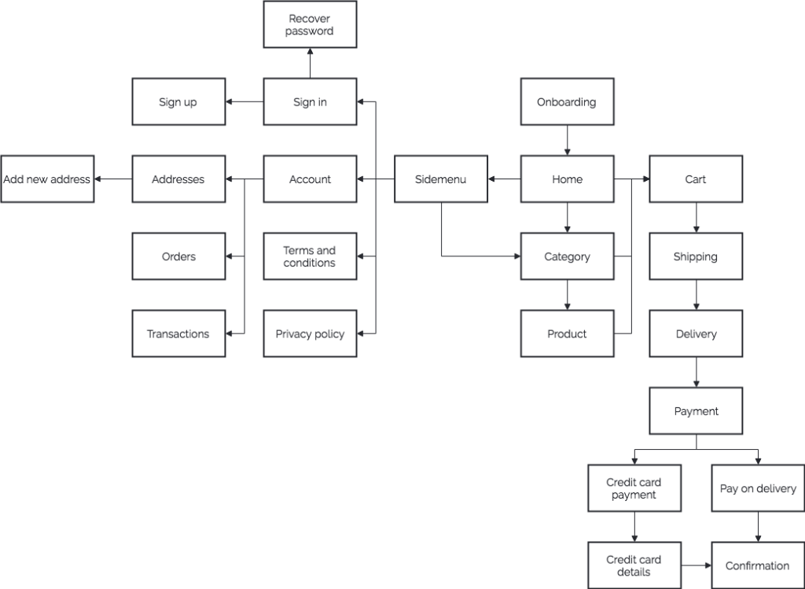
User workflow
There are many different pathways a user can take when interacting with a product.
A user flow is a visual representation, either written out or made digitally, of the many avenues that can be taken when using an app or website.
Depicting this process allows designers to evaluate and optimize the user experience and therefore increase client conversion rates.

Slide 10
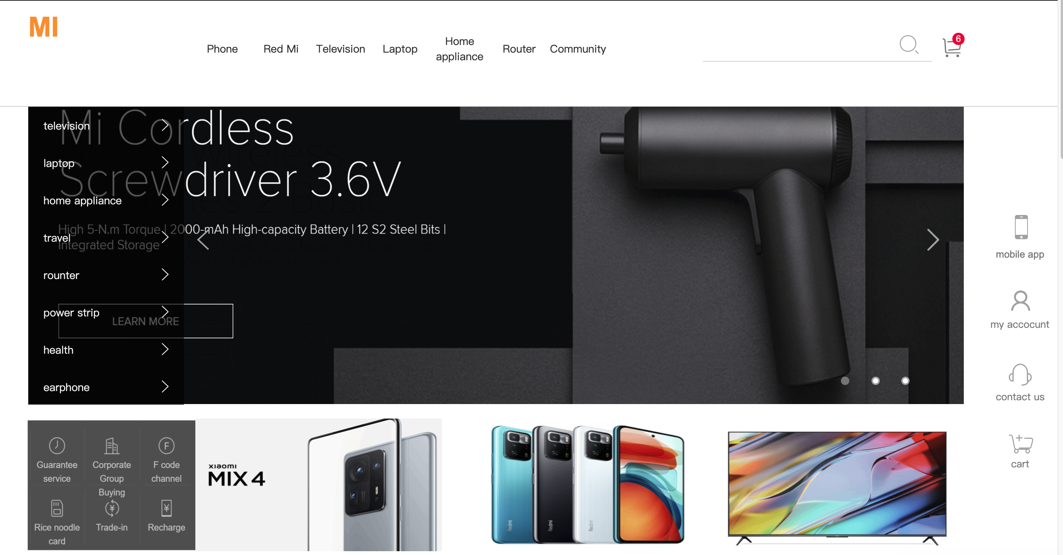
User Onboarding
user-onboarding is a process of orienting and familiarizing new users with a product. It provides the necessary directions and information to get started. It is a process of transforming first-time users into loyal customers.

Slide 11

Brand Identity
Color scheme, primary buttons, font, etc.
XiaoMi brand is orange and its font is square, reflecting the company‘s tech credentials and youthful energy.

Slide 12
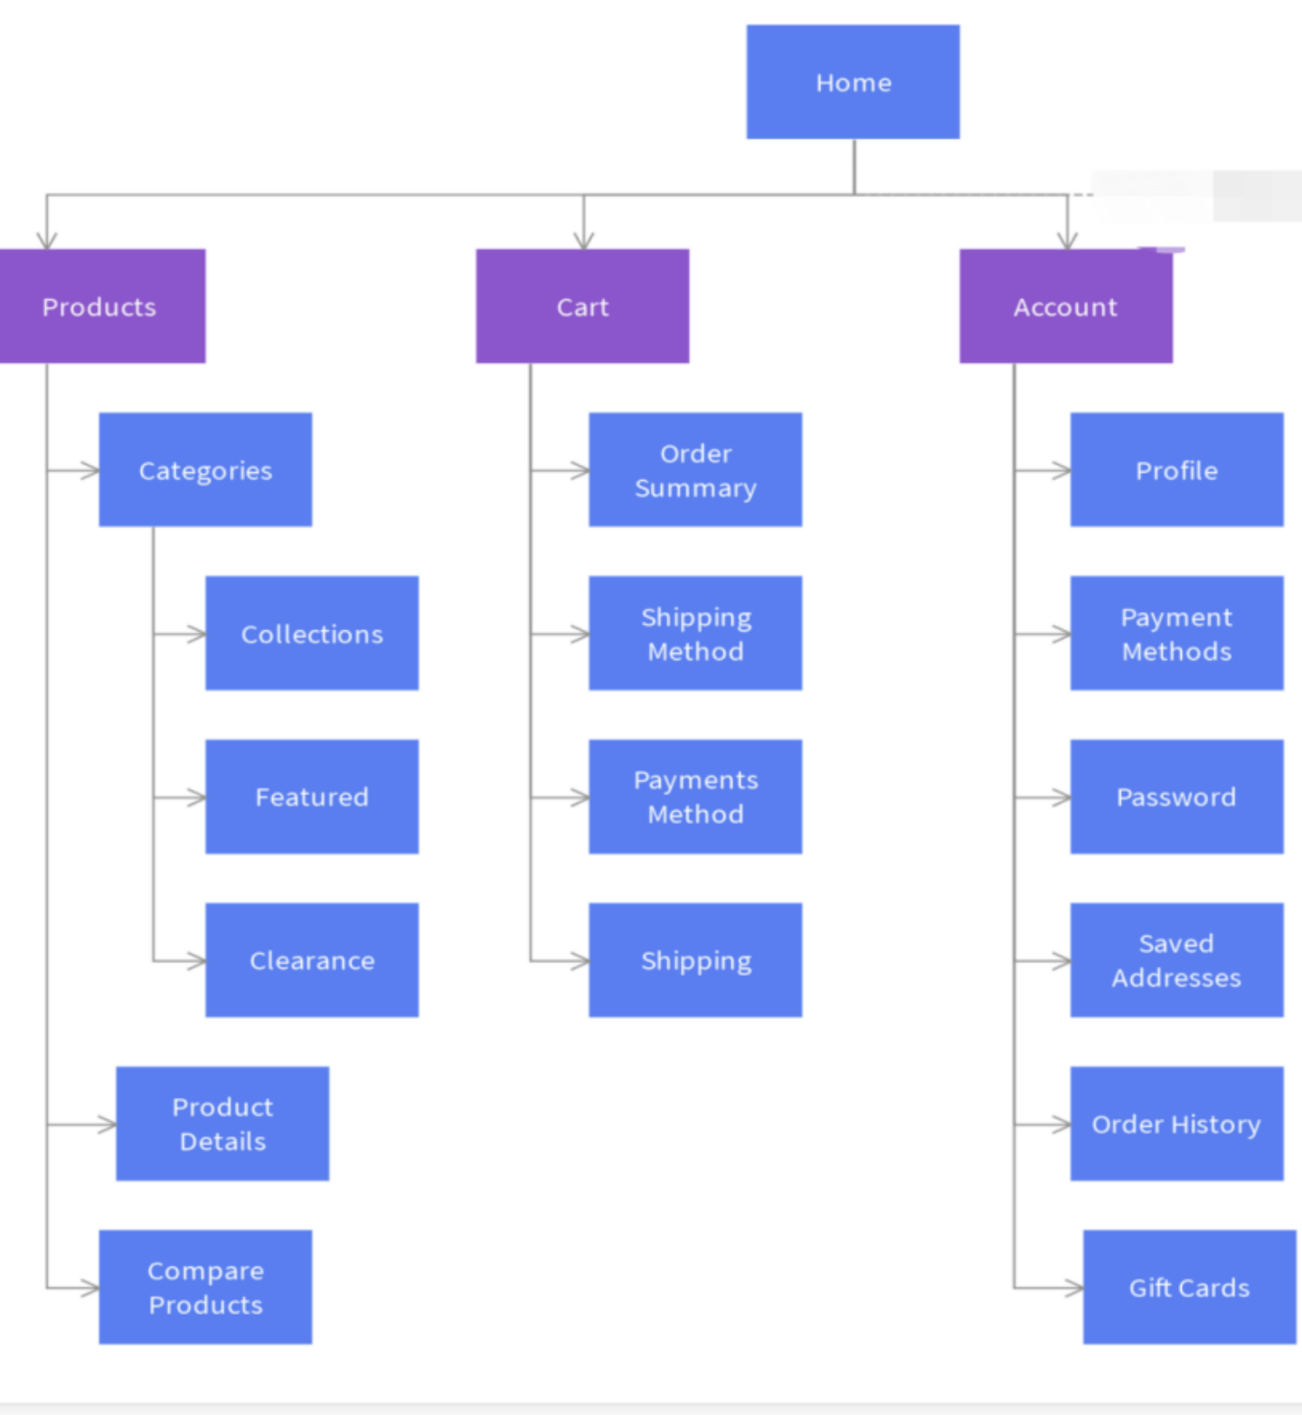
Sitemap
They show how the navigation should be structured.
They help identify where content will sit and
what needs to be produced.
They help show the relationship between different pages.
They provide a structure upon which to begin estimates for development.

Slide 13
Card sorting
Card sorting is a method used to help design or evaluate the information architecture of a site. In a card sorting session, participants organize topics into categories that make sense to them and they may also help you label these groups.
Steps: make cards, ask your users to group the cards, analyze your results.
Open Card Sort: Participants are asked to organize topics from content within your website into groups that make sense to them and then name each group they created in a way that they feel accurately describes the content. Use an open card sort to learn how users group content and the terms or labels they give each category.

Slide 14
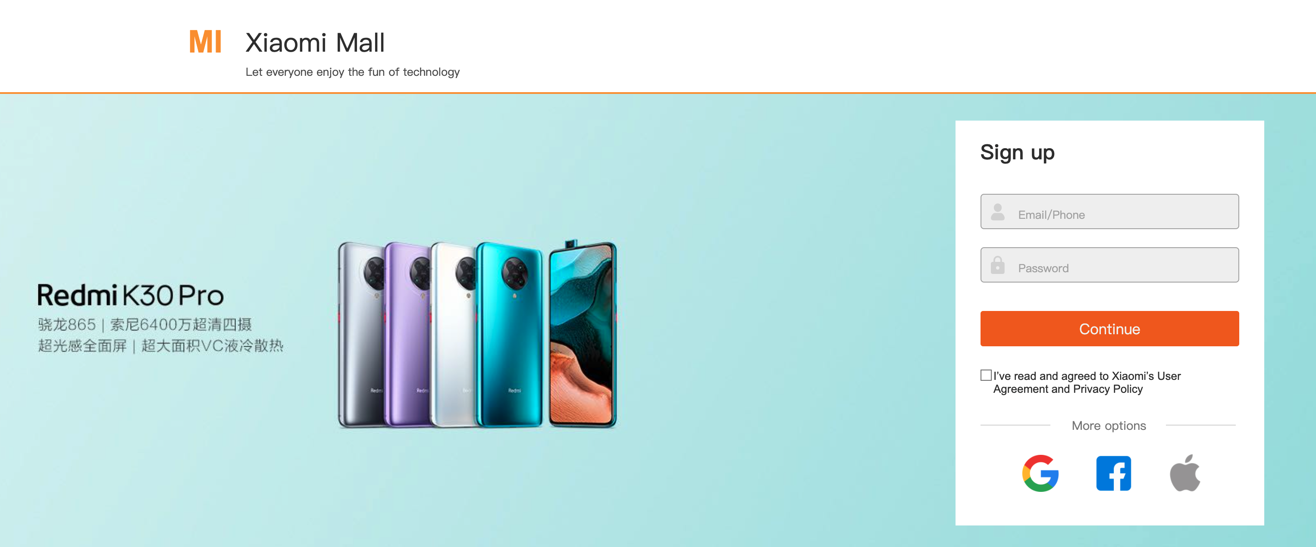
DEMO

Slide 15
Thank you!

